Slide 1

Naming things
Basic Programming Principles
Naming things and making decisions
CODE ACADEMY v3.0

Slide 2
Course Objectives
In this course, students will
be introduced to problem solving scenarios
discuss differences between human brain and computers
be introduced to programming, programmer and algorithms
learn to understand main programming concepts and principal differences
learn about control flows, loops and coding
learn about flowcharts and pseudo-code

Slide 3
Agenda for today
Importance of naming things
Modeling the world
Pseudocode and flowcharts introduction
Solving basic problems
Solving not-so-basic problems
Making decisions

Slide 4
Two hard things in programming
Cache invalidation
Naming things
Off-by-one errors

Slide 5
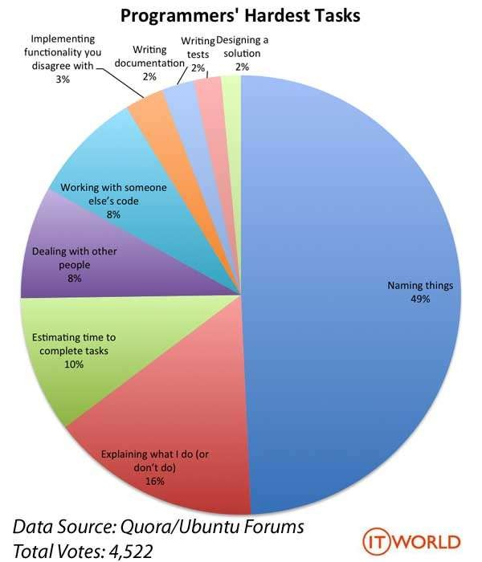
What’s in a name
Must be descriptive
Must be unique
Must not be too short
Must not be too long
Must follow standards

Slide 6
What’s in a name
Should reveal intention
d, list1, theList, query,
Should avoid disinformation AccountList, l, O,
Should be meaningful
a1, a2, .. aN; Product/ProductInfo/ProductData; variable, table, NameString
Should be pronounceable DtaRcrd102

Slide 7
What’s in a name
Should use nouns and verbs correctly GetName, SetName, ChangeName
Should have one word per concept
get, fetch, retrieve - controller, manager, driver
Should have correct opposites
Start with Stop, Open with Close

Slide 8
What’s in a name
Should be consistent
employee.id.Get() dependent.GetId()
supervisor() candidate.id()
Should use solution / problem domain names correctly
Solution domain names (geek terms) for low level code Problem domain names for high level – conceptual code Tree vs. Tree
Best App Ever – BAEAccountAddress, BAECustomer

Slide 9
Models in everyday life
We only get data through our input devices
We form an internal (and consistent) model
We act according to the model
Very obvious in small children

Slide 10
References in everyday life
Names
Identification devices
Sometimes, even names of countries

Slide 11
The map is not the territory
Abstractions are useful tools
Abstractions are powerful tools
Abstractions can be dangerous
Abstractions can be leaky

Slide 12
Example I
Write an algorithm (and draw a flowchart) to convert a length given in feet to meters.

Slide 13
Phases of making a program
A typical programming task can be divided into several phases. Clarification/Analysis phase
make sure we have everything we need to know Problem solving phase
produce an ordered sequence of steps that describe the solution Implementation phase
implement the program in some programming language Testing phase
– verify that our code makes sense and actually works Maintenance phase
verify that our code will need a minimal amount of change

Slide 14
Example I
Write an algorithm (and draw a flowchart) to convert a length given in feet to meters.
Pseudocode (first try):
Input the length in feet
Calculate the length in meters by multiplying with 0.3048
Print length in meters

Slide 15
Example I
Write an algorithm (and draw a flowchart) to convert a length given in feet to meters.
Pseudocode (second try):
Input feetLength (the length in feet)
Calculate meterLength (the length in meters) by multiplying feetLength with 0.3048
Print meterLength

Slide 16
Example I
Write an algorithm (and draw a flowchart) to convert a length given in feet to meters.
Pseudocode (third try):
Input feetLength (the length in feet)
Calculate meterLength (the length in meters) by multiplying feetLength with metersPerFoot (const = 0.3048)
Print meterLength

Slide 17

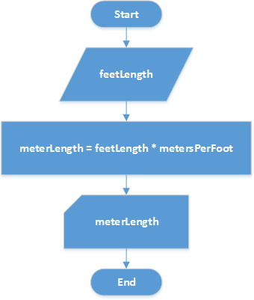
Flowchart

Slide 18
Flowchart
shows the logic of an algorithm
emphasizes individual steps and their interconnections
visualizes control flow from one action to the next

Slide 19
Task II
Write an algorithm and draw a flowchart that will read the two sides of a rectangle and calculate its area
Time: 15 minutes

Slide 20
Example III
Write an algorithm (and draw a flowchart) to determine, given two numbers, if the first one is bigger than the second

Slide 21
Making a decision
We have things called logical expressions They can only be true or false
Their value can always be determined
If can describe a condition we want to test We can make decision based on its outcome
We can take different action based on the value of the condition

Slide 22
If-then-else structure
If condition then
true alternative action else
false alternative action
End-if

Slide 23
If-then-else structure
If first > second then print “Bigger”
else
print “Not bigger” End-if

Slide 24
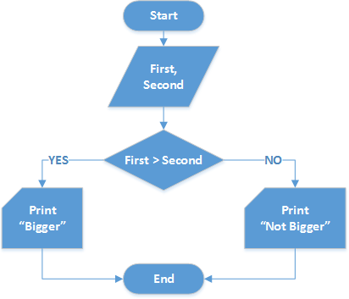
If-then-else flowchart representation

Slide 25
Task IV
Write an algorithm (and draw a flowchart) to read two values from input, determine the largest value, and print it
Time: 15 minutes

Slide 26
Example V
Write an algorithm (and draw a flowchart) to read two values from input, determine their ordering, and print it with an identifying message

Slide 27
Nested If-then-else structure
If first > second then
print “First is bigger” else
If (first < second) then
print “Second is bigger” else
print “They are equal” End-if
End-if

Slide 28
Relational operators
Operator | Description
> | Greater than
< | Less than
= | Equal to
>= | Greater than or equal to
<= | Less than or equal to
!=, <> | Not equal to

Slide 29
Example VI
Write an algorithm (and draw a flowchart) to read three values from input, determine the largest value, and print it with an identifying message

Slide 30
Task VII
Write an algorithm to determine a student’s final grade and indicate whether it is passing or failing.
The final grade is calculated as the average of four marks.
Hint: Ask Questions

Slide 31
Questions & Answers session

